Slide 1
Cloud Computing and Big Data Overview and Introduction
Oxford University
Software Engineering Programme
Nov 2015

Slide 2
Contents
Definitions
Origins of Cloud Computing and Big Data
Case Studies and Motivations

Slide 3

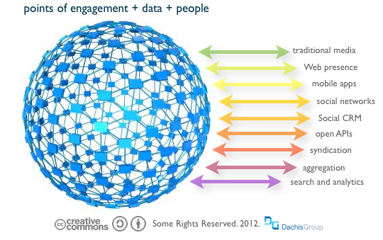
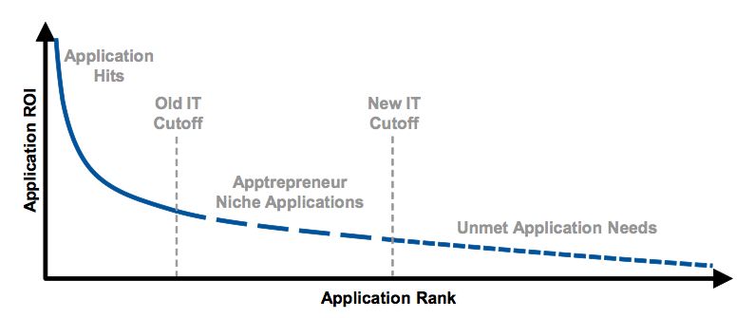
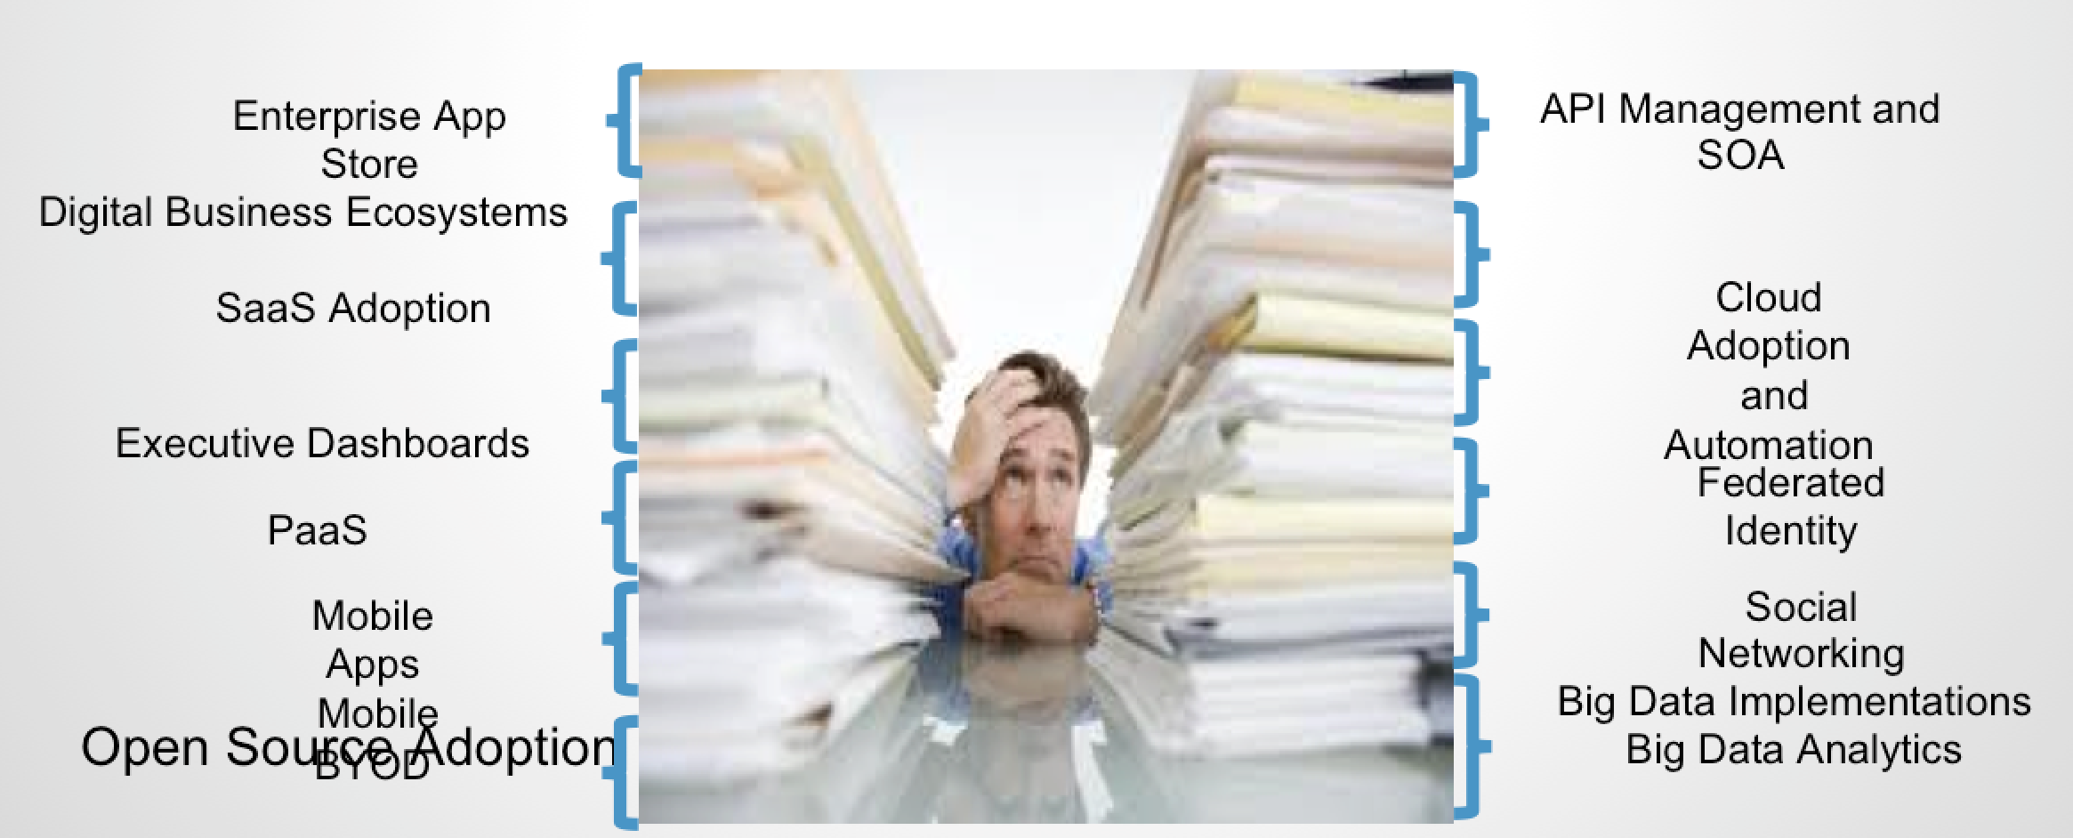
Drivers for a new IT model

Slide 4
What is Cloud?
Depends who you are
My daughter: iCloud (her music in the cloud)
My mum: gmail (her email in the cloud)
My VP sales: Salesforce (his prospects in the cloud)
Sysadmin: Amazon/Rackspace/etc (his infrastructure in the cloud)
*: what you care about, self-provisioned, managed, metered and paid per use, in the cloud

Slide 5
Cloud Computing Definition (NIST)
On-demand self-service
Users can provision resources without human intervention
Broad network access
Heterogeneous access to resources
Resource pooling
Multi-tenant shared capabilities
Rapid elasticity
Services can scale up and down automatically
Measured service
Resources can be metered and charged for based on real-world measures

Slide 6
Cloud Native http://pzf.fremantle.org/2010/05/cloud-native.html
Distributed/Dynamically Wired (works properly in the cloud)
Supports deploying in a dynamically sized cluster
Finds services across applications even when they move
Elastic (Uses the cloud efficiently)
Scales up and down as needed
Works with the underlying IaaS
Multi-tenant (Only costs when you use it)
Virtual isolated instances with near zero incremental cost
Implies you have a proper identity model
Self-service (in the hands of users)
De-centralized creation and management of tenants
Automated Governance across tenants
Granularly Billed and Metered (pay for just what you use)
Allocate costs to exactly who uses them
Incrementally Deployed and Tested (seamless live upgrades)
Supports continuous update, side-by-side operation, in-place testing and incremental production

Slide 7
Origins of Cloud Computing
Virtual Machines on Mainframes
VM/370 – 1972
Grid Computing
Grid computing is the collection of computer resources from multiple locations to reach a common goal.
Software-as-a-Service
Salesforce.com 1999
Amazon AWS
2002

Slide 8
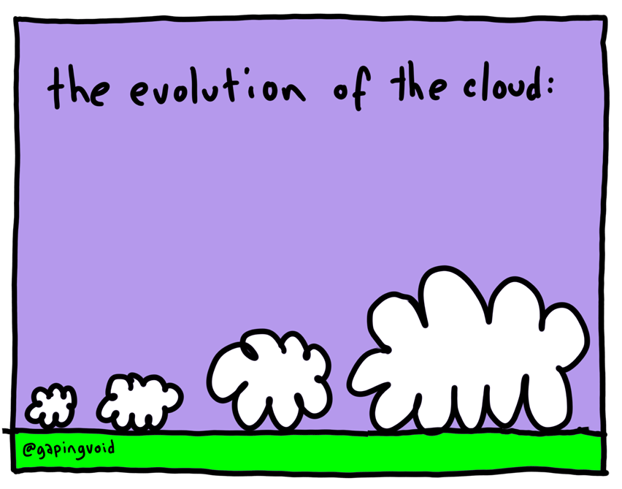

Slide 9
Evolution of Cloud
Containers / Platforms
Infrastructure as a Service
Software as a Service
Virtualization
Grid Computing
Cluster Computing

Slide 10
Big Data definition
Data of a very large size, typically to the extent that its manipulation and management present significant logistical challenges
Oxford English Dictionary

Slide 11
My Big Data definition
Any data storage and analysis that:
Cannot be processed on a single machine in a timely manner
Over time needs more computation and resources than a fixed size system can provide

Slide 12
The three Vs
Velocity
Need to be able to process data faster
Handle very large numbers of data elements/sec incoming
Variety
Not just the same old columns
New formats, new sources, new details
Volume
Massive volumes are becoming normal
Collecting the next level of data
E.g. Bank Trades, Website interactions, shopping experiences, etc

Slide 13

Origins of Big Data - 1997

Slide 14

Map Reduce 2008

Slide 15
Case studies

Slide 16
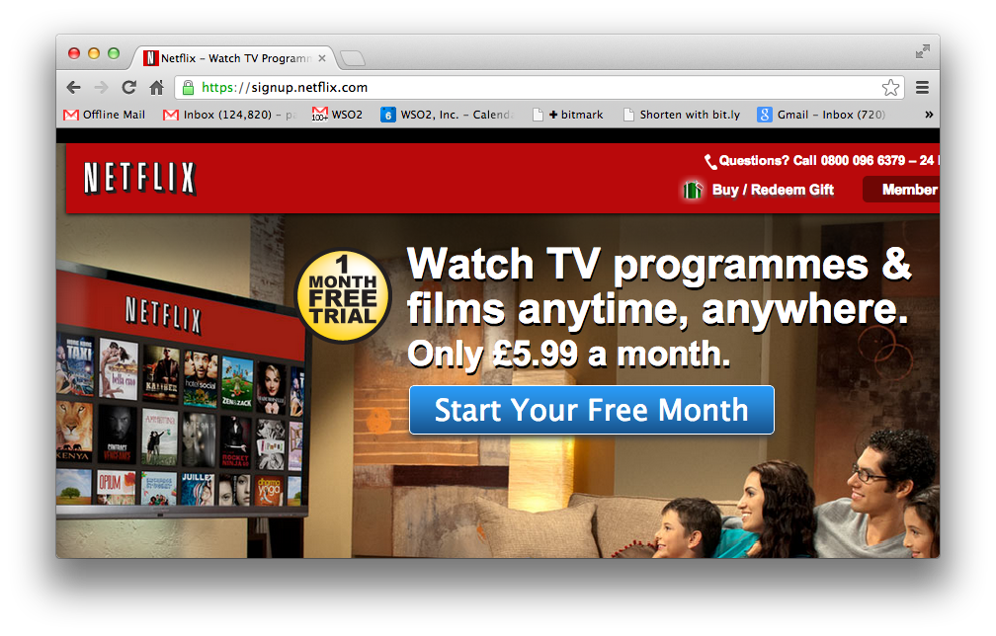

Slide 17
Netflix
A REST and Cloud based SOA approach
Continuous Delivery
100% Based in the cloud
See excellent presentations from Adrian Cockcroft
e.g. http://www.slideshare.net/adrianco/global-netflix-platform

Slide 18
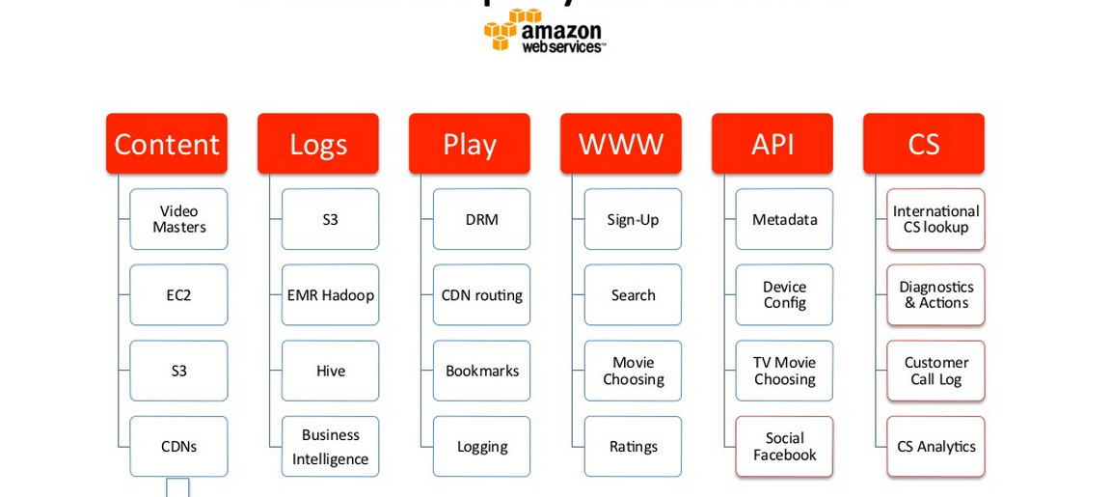
Netflix Deployed on AWS

Slide 19
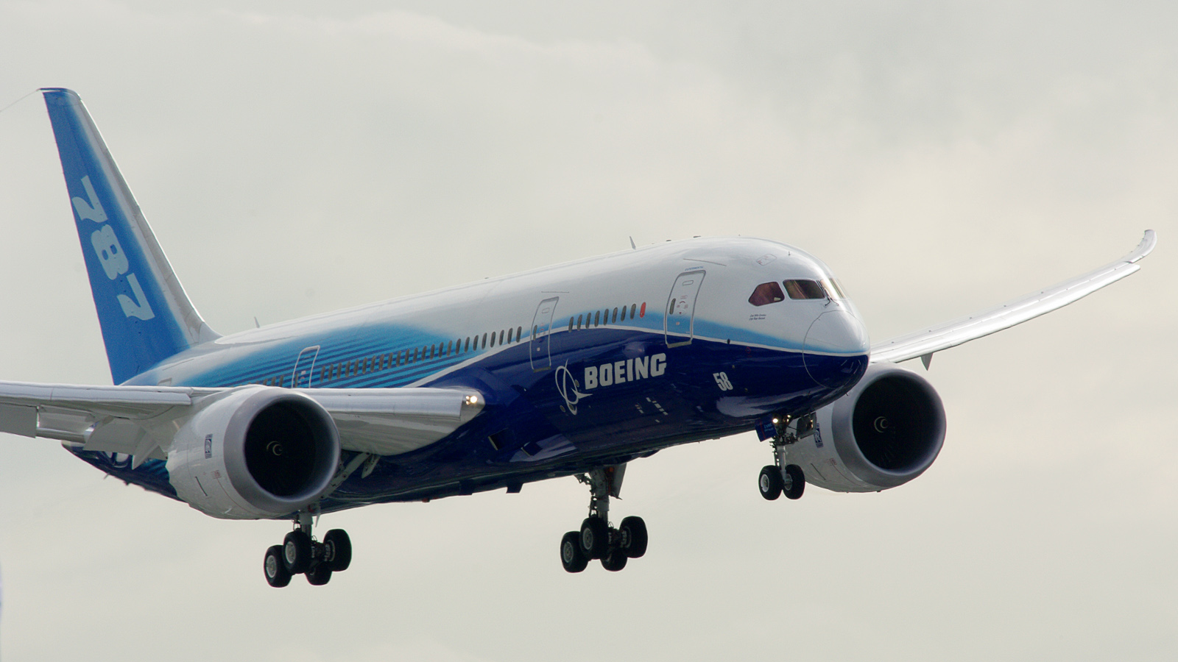
Boeing Digital Airline

Slide 20
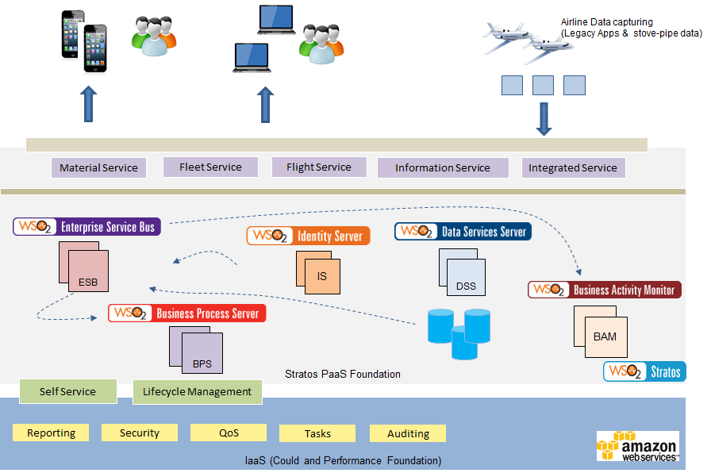
Case Study : Boeing - A PaaS based Integration and API ecosystem
Notes:
Keywords Cloud, API Integration, Billing and Monetization, Governance
Solution Targets to cater for 13,000 Boeing airplanes in Service at 900 airlines
A solution that can scale for 90 million transactions per month (as an end state)
PaaS solution to integrate airlines and OEM data
Reusable app services
Open architecture and modular design

Slide 21
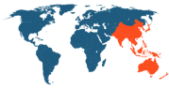
Case Study : Multi-tenanted Mobile Orchestration Gateway Platform
Customer
One of the largest global networking solutions providers required to build a mobile services orchestration gateway platform, enabling mobile providers to simplify QoS service access to their external business partners.
Challenge
- Build a mobile services orchestration gateway than can scale upto 40,000 TPS with 99.999% service availability.
Extensible architecture capable of interfacing with multiple protocols such as XMPP, Diameter whilst maintaining pre-defined SLAs and throughput.
- Integrating with ASR5000K, Third-party PCRF systems
- Multi-tenancy support for API lifecycle management.
- Multi-geographical deployment with autoscaling and failover compensation.
Solution
- Rebuilt an 18 month project in 4 weeks
- API Governance powered by multi-tenanted API Manager cluster with enforced security and lifecycle management.
- Business logic through ESB mediators exposed as REST APIs.
- Stateful caching using Cassandra
- Analytics and monetization of API usage using BAM integrated with enterprise licensing platform.
- Partner Onboarding interfaces and authorization workflows.
- Enterprise-grade cloud deployment based on Stratos PaaS foundation with native support for multi-tenancy, resource pooling and elastic scaling.
Notes:
Keywords Cloud, API Management, Statistics and Monetization, Openstack
Solution 40,000 transactions per second
Support for 99.999% service availability
Support for autoscalling based on Stratos2 implemented on top of Openstack
Tenant based access control for enterprises.
Unified enterprise onboarding
Licensing integration, statistics and monertization

Slide 22
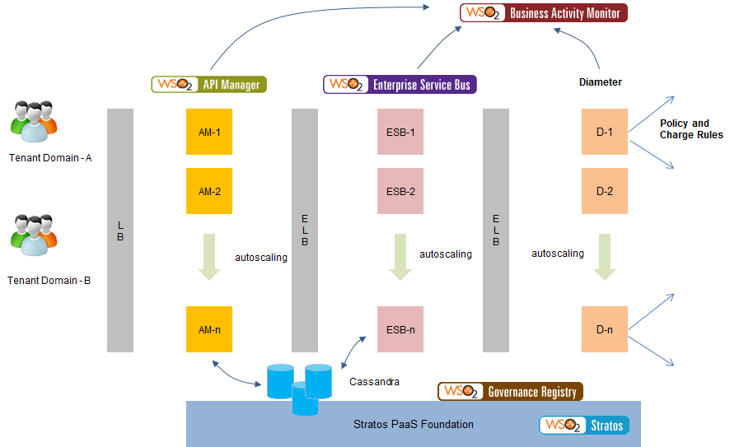
Case Study : Multi-tenanted Mobile Orchestration Gateway Platform
Notes:
Keywords Cloud, API Management, Statistics and Monetization, Openstack
Solution 40,000 transactions per second
Support for 99.999% service availability
Support for autoscalling based on Stratos2 implemented on top of Openstack
Tenant based access control for enterprises.
Unified enterprise onboarding
Licensing integration, statistics and monertization

Slide 23
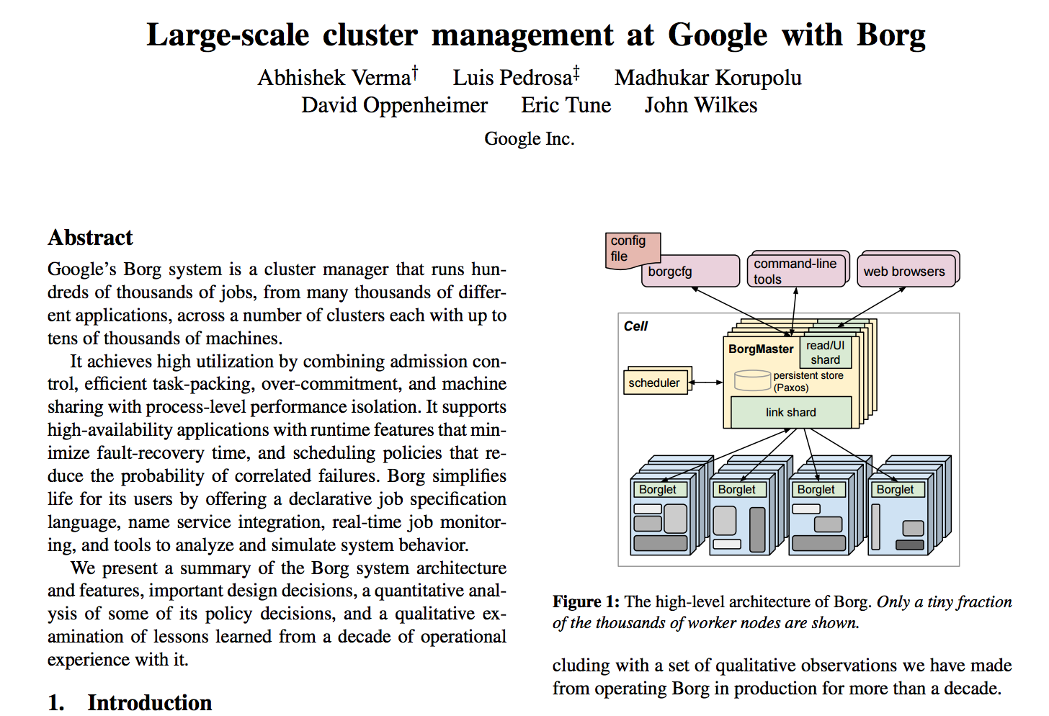

Slide 24

Big Data Cloud management analytics

Slide 25
Realtime Big Data
New York-based Bank
25 servers in a cluster analysing trading and system data from operational systems
Siddhi-based engine processing data in realtime
Handling 10,000s of events/second

Slide 26

https://firstlook.org/theintercept/2015/07/01/nsas-google-worlds-private-communications/

Slide 27

Big Data in Genomics http://www.laboratory-journal.com/science/information-technology-it/big-data-genomics-challenges-and-solutions

Slide 28

Maclaren Formula 1
Collects 1Gb/race
Analysing in real-time to tune and manage the car

Slide 29


Slide 30

Large Hadron Collider Compact Muon Solenoid Source: http://cmsweb.cern.ch/phedex

Slide 31
Questions?

